Slide 1

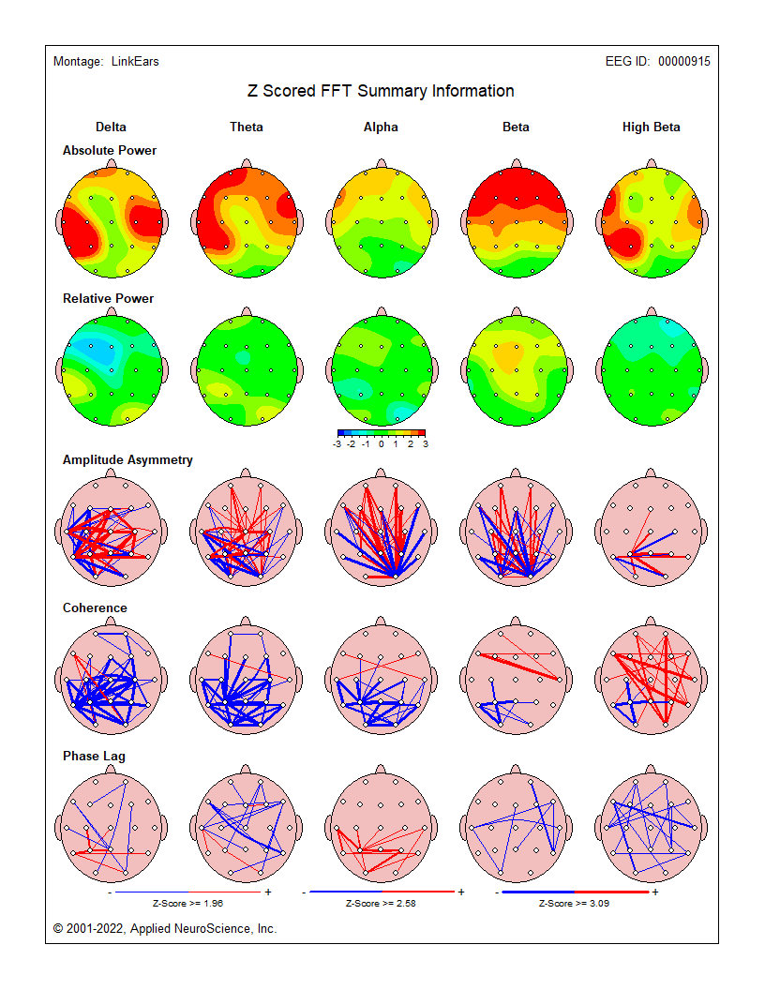
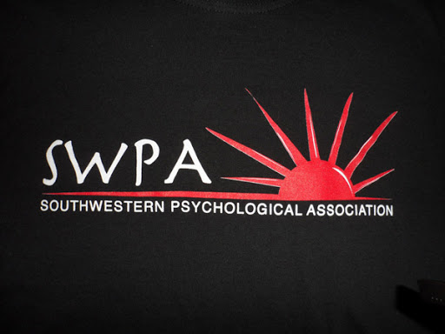
Reducing ADHD Symptoms Using Biofeedback Protocols
Reducing ADHD Symptoms Using Neurofeedback Protocols
Broadway, M., Ashworth, B. & Parker, K.
School of Behavioral and Social Sciences
University of Louisiana Monroe, Monroe, LA
Introduction
Researchers conducted a baseline electroencephalogram (EEG) using Nexus Q32 Mind Media amplifier and software. The symptoms were also measured using the computer administered Integrated Visual and Attention Continuous Processing Test (IVA-2 CPT) (Shreve, 2018). As a tertiary symptom measure, the Behavior Rating Inventory for Executive Functioning for Adults (BRIEF-A) was used, as well. Upon completion of fifteen 30-minute neurofeedback protocol trainings designed to stimulate the sensory motor rhythm (SMR) strip of the brain, administered over a seven-week period, a second EEG was recorded. The IVA-2 CPT and the BRIEF-A were administered post-intervention, also.
RESULTS
Results between the baseline EEG and the post-intervention EEG showed significant improvement in the SMR coherence. The “fast” Fourier transform (FFT) Absolute Power output suggested significant changes in the functioning of the participant’s brain waves, specifically in the High Beta, Low Beta and Gamma values. The initial EEG Low Beta results suggested high levels of inattention, as well as having High Beta output that corresponds with an overactivated prefrontal cortex (PFC). Conversely, the post-training EEG signified positive changes to both the low and high Beta on the FFT Absolute Power output.
In the pre-intervention IVA-2 evaluation, the global Visual Sustained Attention quotient scale score for this individual was 51 (PR=1). This score was found to fall in the extremely impaired range. The post-intervention IVA-2 results suggest that the global Visual Sustained Attention quotient scale score for this individual was 78 (PR=7). This score was found to fall in the mildly to moderately impaired range. All measures of pre-intervention baselines compared with post-neurofeedback protocol trainings suggest that properly modeled treatments may have significant symptom reduction in cases of females experiencing ADHD.
Discussion
The hypothesis posited there would be a significant decrease in ADHD symptoms using neurofeedback protocols. The results suggest a valuable increase in cognitive functioning, possibly due to the increase in participant’s attention. Enhanced neurofeedback training may elicit a calming effect on the “mind spinning” she reported initially, as well as a reduction in a perception of stress, anxiety and feeling “hectic”.
References
Shreve, C. A. (2018). The Effect of TMS on Cognition: A Single Subject Experimental Design Using the IVA-2 Continuous Performance Test (Doctoral dissertation, Oakland University).
Singh, G., Arun, P., Das, S., & Kaur, D. (2021). Can EEG Predict Response to Atomoxetine in attention deficit hyperactivity disorder at 1 Week?. Journal of Attention Disorders, 25(5), 758-767.
McCandless, S., & O'Laughlin, L. (2007). The clinical utility of the Behavior Rating Inventory of Executive Function (BRIEF) in the diagnosis of ADHD. Journal of attention disorders, 10(4), 381-389.
Both the IVA-2 CPT and the BRIEF-A showed significant reduction in ADHD symptoms, between the pre-intervention and the post-intervention neurofeedback protocols.
Attention deficit hyperactivity disorder (ADHD) is a neurodevelopmental and behavioral disorder most associated with children. According to the DSM-5, symptoms include hyperactivity, impulsiveness, and inattentiveness in an individual (Singh, et al., 2015). However, ADHD is also associated with some adults. Adults who experience the symptoms associated with ADHD present with similar indicators as children, though they may not have been officially diagnosed. Inattention does not decrease with maturation of the person. The lack of focus and prioritization with increased forgetfulness are characteristic with adult ADHD presentation.
Purpose
This case study examined whether the adult participant would respond positively to neurofeedback protocols. The project was undertaken to assess if neurofeedback protocols could ameliorate ADHD symptoms without the additional use of medication.
METHODS
The participant was a 36-year-old female adult who reported experiencing ADHD symptoms from childhood. She denied being prescribed any medication to attenuate ADHD symptoms.
BRIEF®-A Score Summary Table
Scale/Index | Raw score | T score | Percentile | 90% CI
Inhibit | 19 | 75 | 98 | 67 - 83
Shift | 14 | 74 | 98 | 66 - 82
Emotional Control | 21 | 64 | 91 | 59 - 69
Self-Monitor | 14 | 72 | 97 | 65 - 79
Behavioral Regulation Index (BRI) | 68 | 75 | 97 | 70 - 80
Initiate | 21 | 81 | >99 | 74 - 88
Working Memory | 22 | 88 | >99 | 81 - 95
Plan/Organize | 28 | 88 | >99 | 82 - 94
Task Monitor | 17 | 88 | >99 | 81 - 95
Organization of Materials | 17 | 63 | 93 | 56 - 70
Metacognition Index (MI) | 105 | 86 | >99 | 82 - 90
Global Executive Composite (GEC) | 173 | 84 | 99 | 81 - 87
Pre-intervention scores
Scale/Index | Raw score | T score | Percentile | 90% CI
Inhibit | 12 | 51 | 67 | 43 – 59
Shift | 10 | 56 | 78 | 48 – 64
Emotional Control | 19 | 60 | 84 | 55 – 65
Self-Monitor | 10 | 55 | 77 | 48 – 62
Behavioral Regulation Index (BRI) | 51 | 57 | 82 | 52 – 62
Initiate | 18 | 71 | 98 | 64 – 78
Working Memory | 17 | 71 | 98 | 64 – 78
Plan/Organize | 19 | 64 | 90 | 58 – 70
Task Monitor | 14 | 74 | 99 | 67 – 81
Organization of Materials | 13 | 51 | 62 | 44 – 58
Metacognition Index (MI) | 81 | 68 | 96 | 64 – 72
Global Executive Composite (GEC) | 132 | 64 | 92 | 61 – 67
BRIEF®-A Score Summary Table
Post-intervention scores

