Slide 1
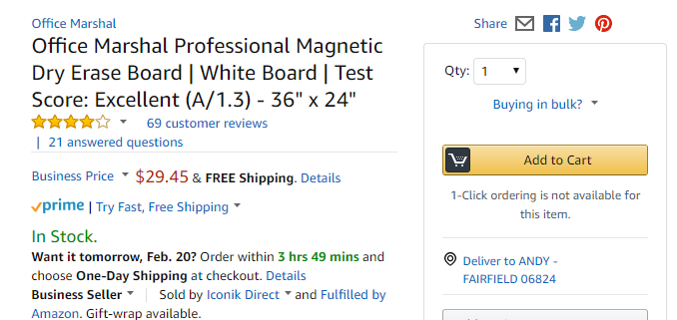
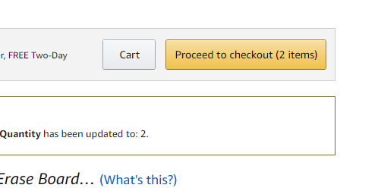
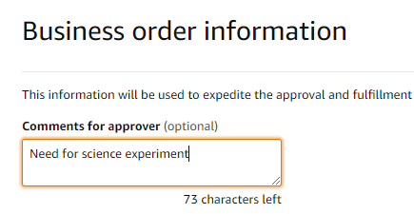
Users Add Items to Cart and Proceed to Checkout

Slide 2
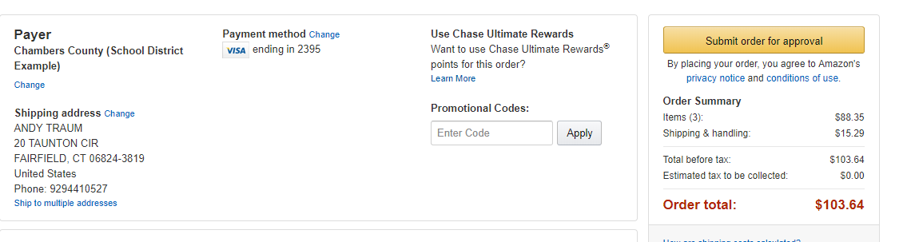
Users Submit Cart For Approval
Once the order is submitted for approval, the user will receive email confirmation for order submitted, approved and delivery date
Approver will receive email that order is pending approval, easily approve or reject, and add PO if needed

