Slide 1




HOW TO
READ AN ACADEMIC ARTICLE
MADELINE MOGHIMI, MLIS

Slide 2


PARTS OF AN ARTICLE
1.
ABSTRACT
2.
INTRODUCTION
3.
LITERATURE REVIEW
4.
METHODOLOGY
5.
RESULTS
6.
DISCUSSION
7.
CONCLUSION

Slide 3
PARTS OF AN ARTICLE
CONTINUED
1.
ABSTRACT
An abstract is a summary of an article. It highlights the most important information and can let you know if it is relevant to your research needs.
2.
INTRODUCTION
The introduction introduces the study. It informs readers about the topic and lets them know where the study is going.

Slide 4
PARTS OF AN ARTICLE
CONTINUED
3.
LITERATURE REVIEW
A literature review examines what has already been written about the topic. This allows authors to build on the work of others.
4.
METHODOLOGY
The methodology explains exactly how the study was done. It allows other researchers a chance to better understand the results.

Slide 5
PARTS OF AN ARTICLE
CONTINUED
5.
RESULTS
This section presents the results of the study. It often contains lots of numbers, charts, and graphs.
6.
DISCUSSION & CONCLUSION
These sections are often combined as they have a similar focus. They wrap up the article, discuss the results, and consider possible ways the research could be extended.

Slide 6

READING ORDER
1.
Abstract
2.
Discussion
3.
Introduction
4.
Results
5.
Methodology
6.
Conclusion

Slide 7
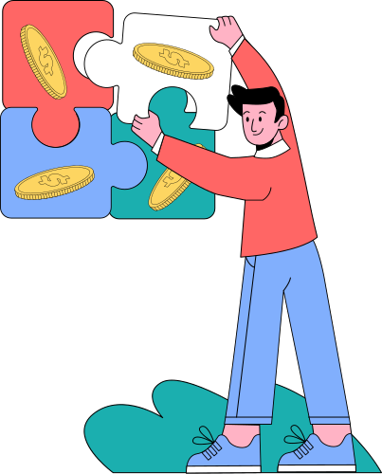



READ IT AGAIN!
Don't just read the paper one time and expect to have a thorough understanding. To fully understand a paper, you may need to read it 2 to 3 times. When reading, focus on the sections that were the least clear, but still relevant to your needs.

Slide 8



ANNOTATE
  *or Underline/Highlight things that you consider important.
  ? if something is confusing or you feel you may need to return to.
  ! when you find something particularly interesting, insightful, or juicy.
  + When you make a connection to another concept or article.
  Circle unfamiliar terms. When you finished reading, return and define them if needed.
  Notes Write notes in the margins to keep yourself on track and keep up with relevant ideas.

Slide 9
HARD TO READ?
It's no secret that journal articles are hard to read. But why are they do difficult?
1.
Not made for leisure reading
Academic journal articles are not typically intended to be an entertaining read.
2.
Not meant to be read straight through
Unlike most things you read, academic articles are not meant to be read straight through. Authors expect readers to jump around to better digest the information.
3.
Information packed
Academic articles are typically filled with a wealth of knowledge, which can result in a dense read.

Slide 10

CONTACT US
Email: Reference@ulm.edu
Voicemail: (318) 342-1071
Webform: Ask-a-Librarian

