Slide 1







APA BASICS:
7TH EDITION FORMATTING AND CITATIONS
Katie Massey
Reference Librarian
ULM University Library

Slide 2




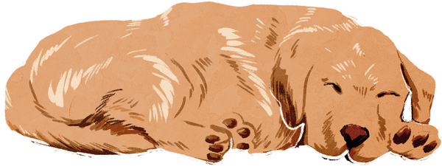

Overview
  Introduction
  General paper formatting and structure
  In-text citations
  Reference list

Slide 3




Introduction
What is APA style?
  Research writing and citation guidelines created by the American Psychological Association (APA)
What types of subjects use APA?
  Business
  Social Sciences
  Health Care
  AND Other Related Fields

Slide 4

Paper Structure and Formatting:
General Information
Text:
  Must be a legible font
  Recommended Times New Roman, Arial, Calibri, etc.
  10-12 point (depends on the font)
  Double-spaced
  Left-aligned
Margins:
  1 inch margins on all sides
Paragraphs:
  New paragraphs indented half-inch (i.e. using tab key)
Pages:
  Numbered in top right corner
APA, 2020.

Slide 5
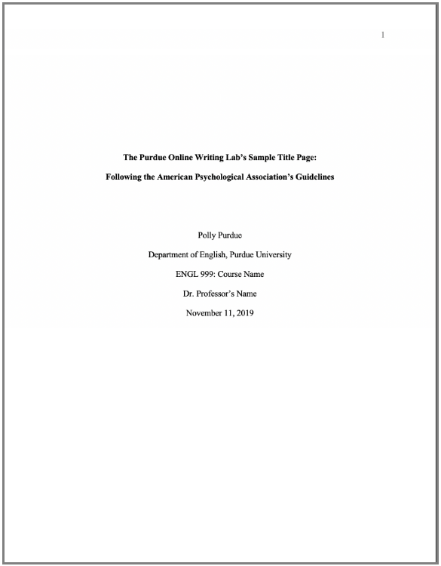

Title Page
Format:
  Double-spaced
  Centered
  Upper-half of page
  Insert page number
Numbered pages begin on Title Page
Organization:
  Title: 1-2 lines, bolded
  Author's name
  Institution affiliation
  Class information
  Instructor's name
  Assignment due date
Purdue Online, n.d.a

Slide 6
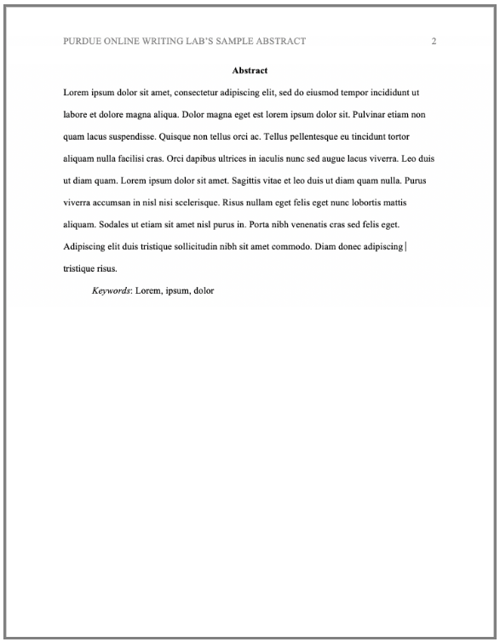
Abstract*
Title in header is not required for student papers!
General Information:
  One paragraph
    Double-spaced
    Not indented
    Summary of key points
    Typically no more than 250 words
  “Abstract” is bold and centered
  Keywords (if applicable)
    Indented
    “Keywords” is italicized
*Abstracts are not generally required for student papers!
Purdue Online, n.d.a

Slide 7
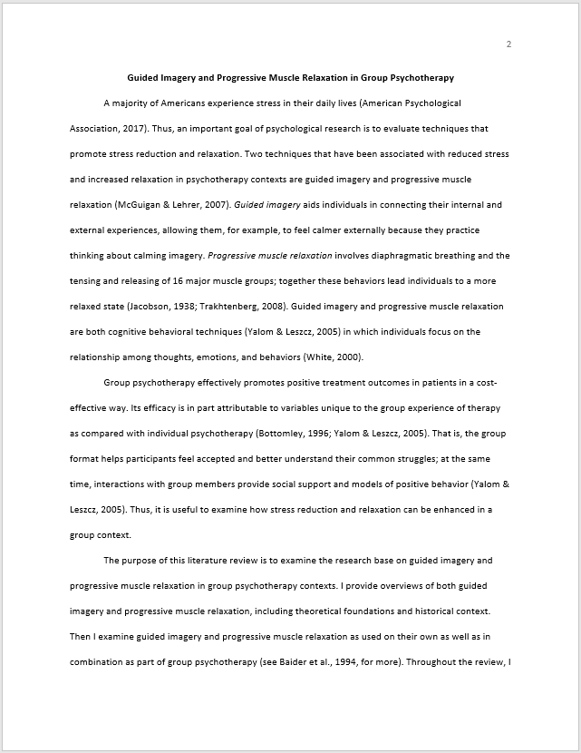
Main Body
Title is bold and centered
General Information:
  Follows a 5 level heading system
  Text
    Left-aligned
    New paragraphs are indented
    Legible font
    Double-spaced
Contains in-text citations
New paragraphs are indented
APA, 2020

Slide 8
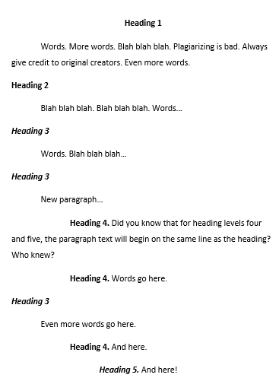
Headings
APA uses a 5 level system.
APA Headings
Level | Format
1 | Centered, Boldface, Title Case Heading
2 | Flush Left, Boldface, Title Case Heading
3 | Flush Left, Boldface Italic, Title Case Heading
4 | Indented, Boldface Title Case Heading Ending With a Period.
5 | Indented, Boldface Italic, Title Case Heading Ending With a Period.

Slide 9
What can be cited?
  Books
  eBooks
  Book chapters
  Magazines
  Newspapers
  Journal articles
  Webpages
  Interviews
  Infographics
  Emails
  Online forums
  Social media profiles
  Facebook posts
  Instagram photos/stories/reels
  Blog posts
  YouTube videos
  Podcasts
  Vodcasts
  TV series
  Episodes
  Music
  ChatGPT
  AND MORE...

Slide 10



In-text Citations
General Information:
  Include author(s) and date
  Direct quotes require a page number or other identifier
    Use “p.” for page or “pp.” for pages
    Use “para.” for paragraph or “paras.” for paragraphs
    “Table” or “Figure” may also be used if applicable
  Use a shortened title if there is not an author
  Use "n.d." if there is no date
  Short quotes in quotations
  Longer quotes in block text
Purdue Online, n.d.b

Slide 11
In-text Examples:
Single Author
If the author’s name is mentioned in an introductory phrase, it is followed by the publication date. The page number for a direct quote is located at the end of the sentence before the ending punctuation.
  According to Broadhead (2022), "popular culture plays an important role in the struggle over socially acceptable ideas" (p. 3).
  Broadhead (2022) stated "popular culture plays an important role in the struggle over socially acceptable ideas" (p. 3).
If the author’s name is not mentioned in an introductory phrase, include the author, date, and page number (if applicable) in a parenthetical citation before the sentence’s ending punctuation.
  She determined that "popular culture plays an important role in the struggle over socially acceptable ideas" (Broadhead, 2022, p.3).

Slide 12
In-text Examples:
Two Authors
If the authors’ names are mentioned in an introductory phrase, they are connected by the word “and” then followed by the publication date. The page number for a direct quote is then placed at the end of the sentence before punctuation.
  Freedland and Young (2022) observed how, "the subsequent human ingestion of vampire blood introduces a bloodborne virus that drives the transformation from human to vampire" (p. 18).
If the authors’ names are not mentioned in an introductory phrase, include the authors’ names connected by an ampersand (&), date, and page number (if applicable) in a parenthetical citation before the sentence’s ending punctuation.
  Supported by evidence, "the subsequent human ingestion of vampire blood introduces a bloodborne virus that drives the transformation from human to vampire" (Freedland & Young, 2022, p. 18).

Slide 13
In-text Examples:
Three or More Authors
To include author information in an introductory phrase, list the first author’s name followed by the words “et al.” to represent the other authors. Provide the publication date after the author information. The page number for a direct quote is then placed at the end of the sentence before punctuation.
  Bates et al. (2005) determined that, "unfortunately, the power to save the world is unrelated to social acceptability" (p. 3).
If the authors’ names are not mentioned in an introductory phrase, include the first author’s name followed by “et al.,” date, and page number (if applicable) in a parenthetical citation before the sentence’s ending punctuation.
  Results showed that "unfortunately, the power to save the world is unrelated to social acceptability" (Bates et al., 2005, p. 3).

Slide 14
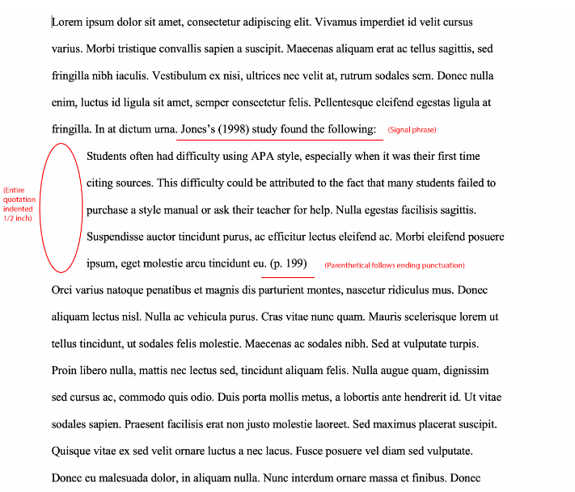
Long Quotes
General Information:
  Quotes that are 40 words or longer
  No quotation marks
  Entire quote is indented
  Citation comes after ending punctuation
Purdue Online, n.d.b

Slide 15
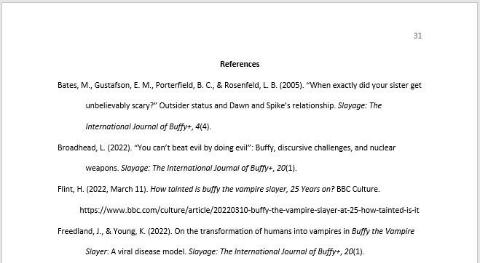
References
General Information:
  On a new page after the main body
  Lists each source that was cited in the paper
  Double-spaced
  Hanging indentations
  Alphabetized by the last names of authors
    For sources written by the same author, list chronologically
  Citation entries use sentence case
“References” is bold and centered!
All lines of the citation except for the first are indented
Purdue Online, n.d.c

Slide 16

Sentence Case
What is sentence case?
  In title case, major words like nouns, verbs, adjectives, adverbs, and pronouns are capitalized, but minor words like conjunctions, prepositions, and articles are lowercase.
  In sentence case, the words found in titles of articles, books, websites, and other works are primarily lowercase
Capitalize these words using sentence case:
  First word of a title
  First word of a subtitle
  First word after a colon, em dash, or end punctuation
  Nouns followed by numerals or letters
  Proper nouns
APA, 2019

Slide 17


Sentence Case:
Example
This citation shows correct usage of sentence case.
O’Kelly, M. K., Jeffryes, J., Hobscheid, M., & Passarelli, R. (2023). Correlation between library instruction and
student retention: Methods and implications. College & Research Libraries, 84(1), 85–99. https://doi.org/10.5860/crl.84.1.85
Only the first word of the title and first word after the colon are capitalized!
This citation does not.
O’Kelly, M. K., Jeffryes, J., Hobscheid, M., & Passarelli, R. (2023). Correlation between library instruction and
student retention: Methods and implications. College & Research Libraries, 84(1), 85–99. https://doi.org/10.5860/crl.84.1.85
All major words are capitalized using title case.

Slide 18
What makes up a citation?
All APA citations follow the same general pattern!
  Author information
  Publication date
  Title of the work
  Information about the source of the work

Slide 19



Citation Examples
The next few slides provide a range of examples to illustrate the general pattern APA citations often follow; however, when conducting your own research, you may encounter sources or situations not covered in this presentation!
Discover more APA citation guidelines at owl.purdue.edu, apastyle.apa.org, or find the Publication Manual of the American Psychological Association, 7th Edition in the ULM Library!

Slide 20
Creating Citations:
Author(s)
Single Author
List the author’s last name followed by initials.
Example: Broadhead, L.
Two Authors
List the authors’ last names followed by initials, separate them with a comma, and combine them with an ampersand (&).
Example: Freedland, J., & Young, K.
Three to Twenty Authors
List the authors’ last names followed by initials, separate them with a comma, and precede the final author’s name with an ampersand (&).
Example: Bates, M., Gustafson, E. M., Porterfield, B. C., & Rosenfeld, L. B.

Slide 21
Creating Citations
  Journal Article
Author(s). (Year). Title of article. Title of Periodical, volume(issue), pages. DOI (if available)
Example:
Bates, M., Gustafson, E. M., Porterfield, B. C., & Rosenfeld, L. B. (2005). “When exactly did your sister get unbelievably scary?” Outsider status and Dawn and Spike’s relationship. Slayage: The International Journal of Buffy+, 4(4).
  News Article
Author(s). (Year, Month Date). Title of article. Title of Publication. URL
Example:
Hunter, T. (2023, July 31). Online book clubs are exploding. Let’s find the right one for you. Washington Post. https://www.washingtonpost.com/technology/2023/07/31/book- club-online-in-person/

Slide 22
Creating Citations
  Book or eBook
Author(s). (Year). Title of work. Publisher. DOI or URL (if available)
Example:
Kossowska, M., & Rosiński, J. (2024). Global mindset and international business. Taylor & Francis. https://doi.org/10.4324/9781003407263
  Edited Book, No Author
Editor (Ed.). (Year). Title of work. Publisher. DOI (if available)
Example:
Niininen, O. (Ed.). (2022). Contemporary issues in digital marketing. Taylor & Francis. https://doi.org/10.4324/9781003093909

Slide 23
Creating Citations
  Published Dissertation or Master’s Thesis
Author. (Year). Title of dissertation/thesis (Publication No.) [Doctoral dissertation/Master’s thesis, Name of Institution Awarding the Degree]. Database or Archive Name.
Example:
Wheelis, P. R. (1999). The relationship of teaching style and computer use in classrooms of northeast Louisiana (Publication No. 9956493.) [Doctoral dissertation, The University of Louisiana at Monroe]. ProQuest Dissertations & Theses A&I.
  Website Containing Content Likely to Change Over Time
Author(s). (Year, Month Date). Title of page. Site name. Retrieved Month, Date, and Year, from URL
Example:
Central Intelligence Agency. (2023, July 12). Antarctica. The World Factbook. Retrieved July 31, 2023, from https://www.cia.gov/the-world-factbook/countries/antarctica/

Slide 24



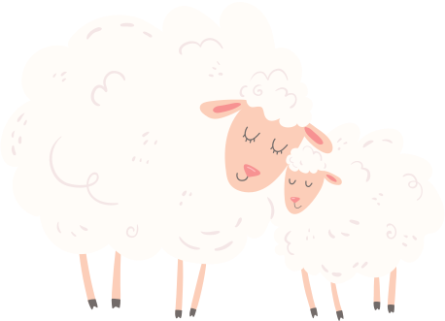

Resources
Contact a Librarian:
  reference@ulm.edu
Citation Help:
  owl.purdue.edu
  apastyle.apa.org
  Publication Manual of the American Psychological Association, 7th Edition
The Write Place:
  Walker Hall 3-87

Slide 25


Questions?
Thank You!
Happy Writing!

Slide 26
References
APA. (2019). Sentence Case Capitalization. https://apastyle.apa.org/style-grammar-guidelines/capitalization/sentence-case
APA. (2020). Publication manual of the American Psychological Association (7th ed.). American Psychological Association.
Purdue Online Writing Lab. (n.d.a). General Format. Purdue Online Writing Lab. https://owl.purdue.edu/owl/research_and_citation/ apa_style/apa_formatting_and_style_guide/general_format.html
Purdue Online Writing Lab. (n.d.b). In-text citations: The basics. Purdue Online Writing Lab. https://owl.purdue.edu/owl/research_and _citation/apa_style/apa_formatting_and_style_guide/in_text_citations_the_basics.html
Purdue Online Writing Lab. (n.d.c). Reference list: Basic Rules. Purdue Online Writing Lab. https://owl.purdue.edu/owl/research_and_ citation/apa_style/apa_formatting_and_style_guide/reference_list_basic_rules.html

